Slide 1
UNIT 3-S3-SLO2 DISPLAY DETECTION DEVICESDEVICES,LIGHT SOURCES AND

Slide 2
Light-Emitting Diodes (LEDs)
For optical communication systems requiring bit rates less than approximately 100–200 Mb/s together with multimode fiber-coupled optical power in the tens of microwatts, semiconductor light-emitting diodes (LEDs) are usually the best light source choice.
These LEDs require
Less complex drive circuitry than laser diodes
No thermal or optical stabilization circuits are needed
They can be fabricated less expensively with higher yields.

Slide 3
LED Structures
To be useful in fiber transmission applications, an LED must have a high radiance output, a fast emission response time, and a high quantum efficiency.
Its radiance (or brightness) is a measure, in watts, of the optical power radiated into a unit solid angle per unit area of the emitting surface.
High radiances are necessary to couple sufficiently high optical power levels into a fiber.
The emission response time is the time delay between the application of a current pulse and the onset of optical emission.
This time delay is the factor limiting the bandwidth with which the source can be modulated directly by varying the injected current.
The quantum efficiency is related to the fraction of injected electron–hole pairs that recombine radiatively.

Slide 4
To achieve a high radiance and a high quantum efficiency, the LED structure must provide a means of confining the charge carriers and the stimulated optical emission to the active region of the pn junction where radiative recombination takes place.
Carrier confinement is used to achieve a high level of radiative recombination in the active region of the device, which yields a high quantum efficiency.
Optical confinement is of importance for preventing absorption of the emitted radiation by the material surrounding the pn junction.

Slide 5
LED DESIGNS
Two basic structures of LED are in use. These are (i) surface-emitting LED (SLED) and (ii) edge-emitting LED (ELED).
Configurations based on GaAs/ GaAlAs have been used in short-haul applications, whereas those based on InGaAsP/ InP have been employed in medium-range fiber links.
Relatively recently, a third device known as a super luminescent diode (SLD) has also been increasingly used in communications.

Slide 6
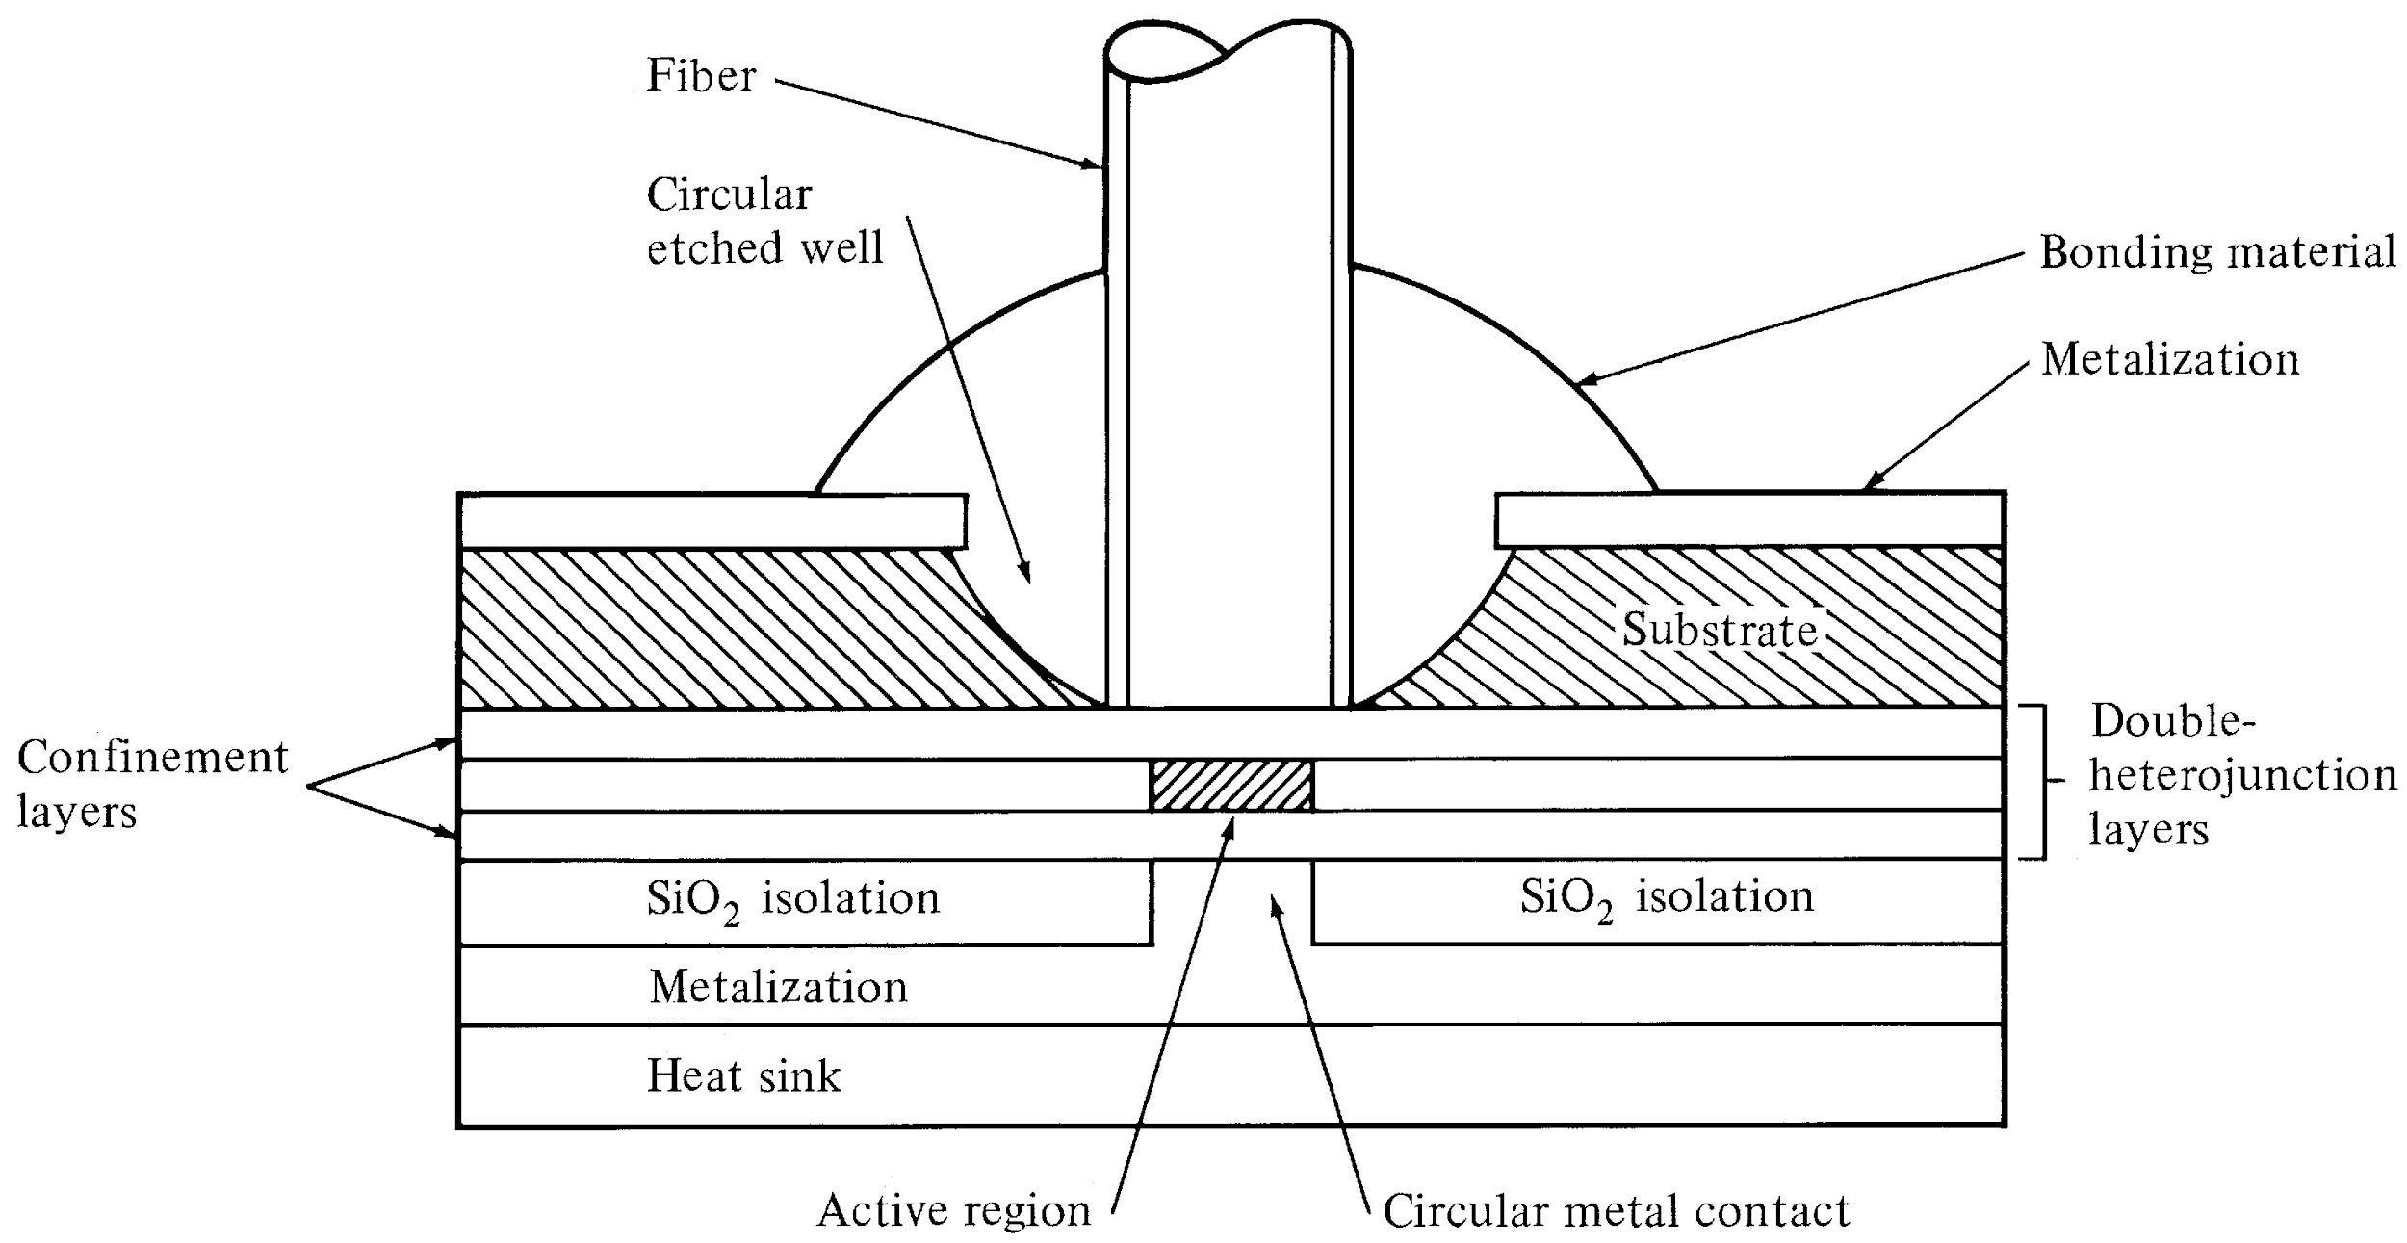
Surface-Emitting LED
Schematic of high-radiance surface-emitting LED. The active region is limitted
to a circular cross section that has an area compatible with the fiber-core end face.
Optical Fiber communications, 3rd ed.,G.Keiser,McGrawHill, 2000

Slide 7

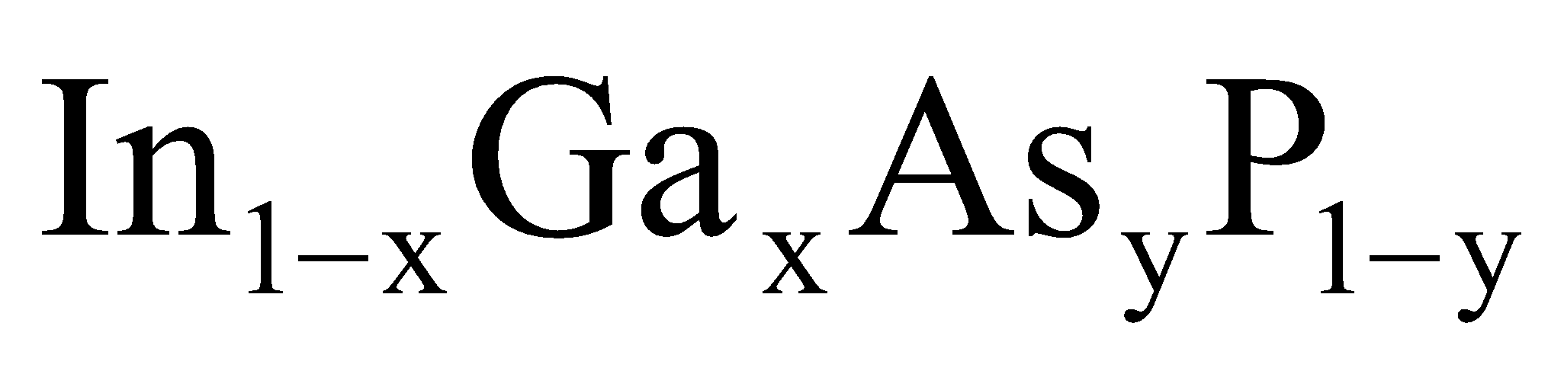
Light Source Material
Most of the light sources contain III-V ternary & quaternary compounds.
by varying x it is possible to control the band-gap energy and thereby the emission wavelength over the range of 800 nm to 900 nm. The spectral width is around 20 to 40 nm.
By changing 0<x<0.47; y is approximately 2.2x, the emission wavelength can be controlled over the range of 920 nm to 1600 nm. The spectral width varies from 70 nm to 180 nm when the wavelength changes from 1300 nm to 1600 nm. These materials are lattice matched.

Slide 8
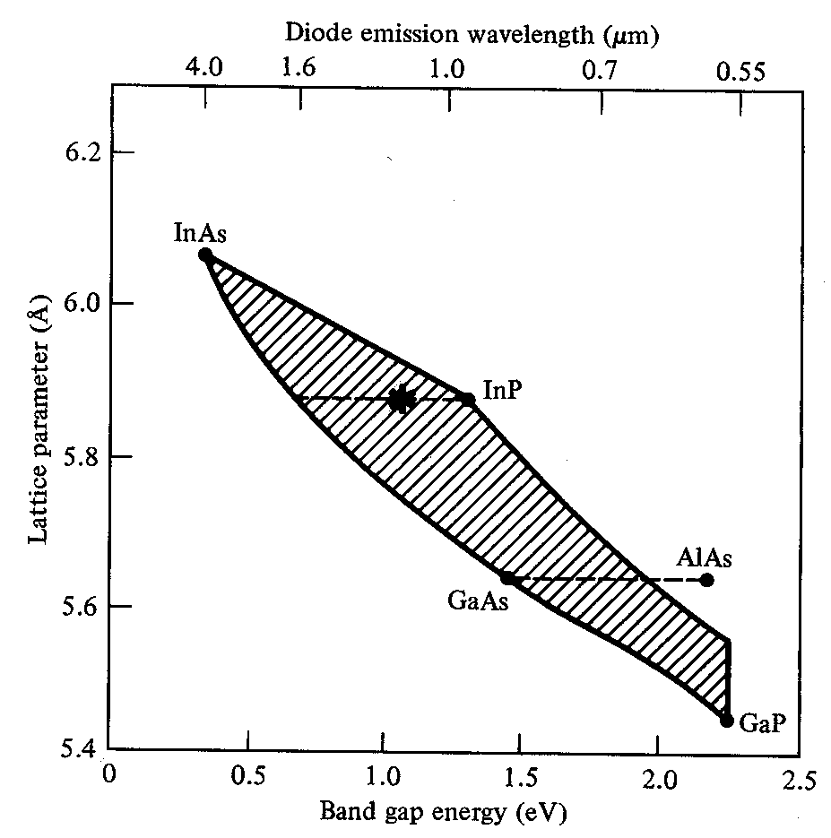
Optical Fiber communications, 3rd ed.,G.Keiser,McGrawHill, 2000

Slide 9
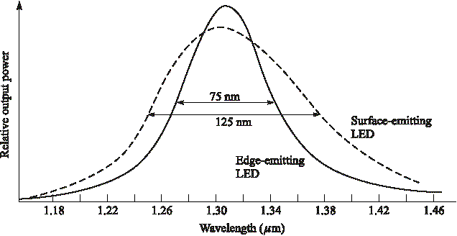
Spectral width of LED types
Optical Fiber communications, 3rd ed.,G.Keiser,McGrawHill, 2000

Slide 10
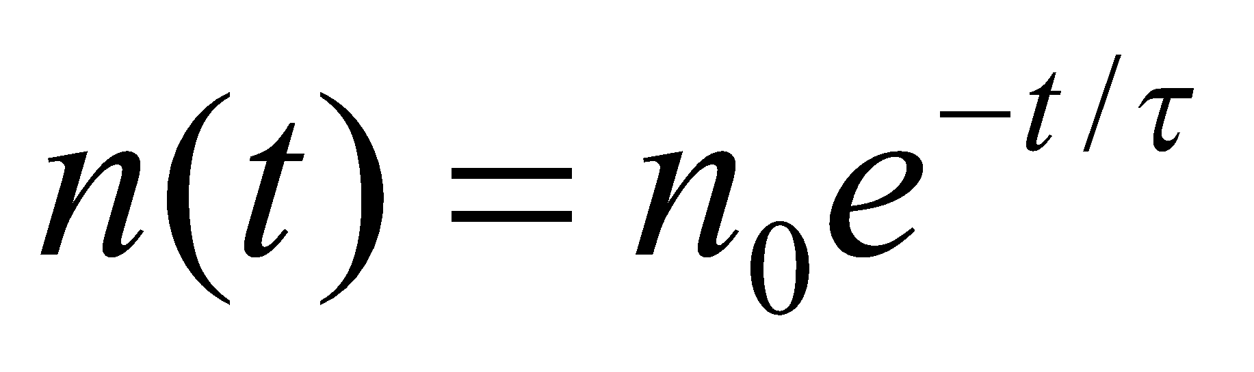
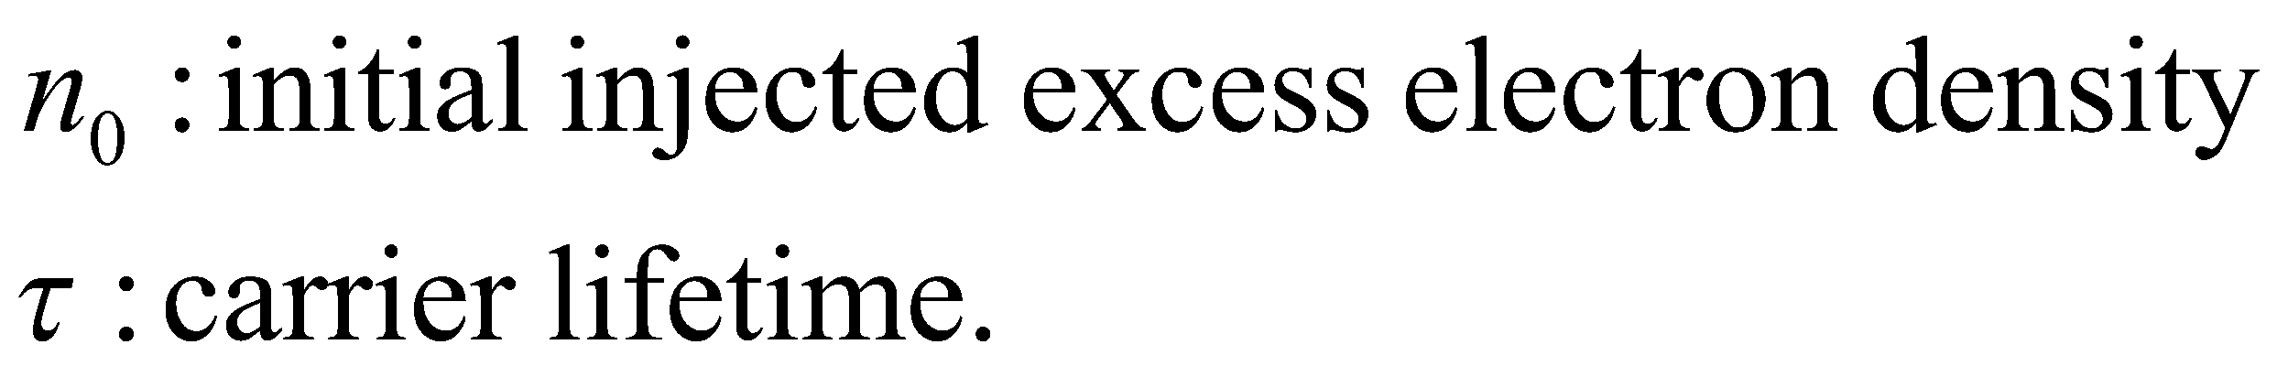
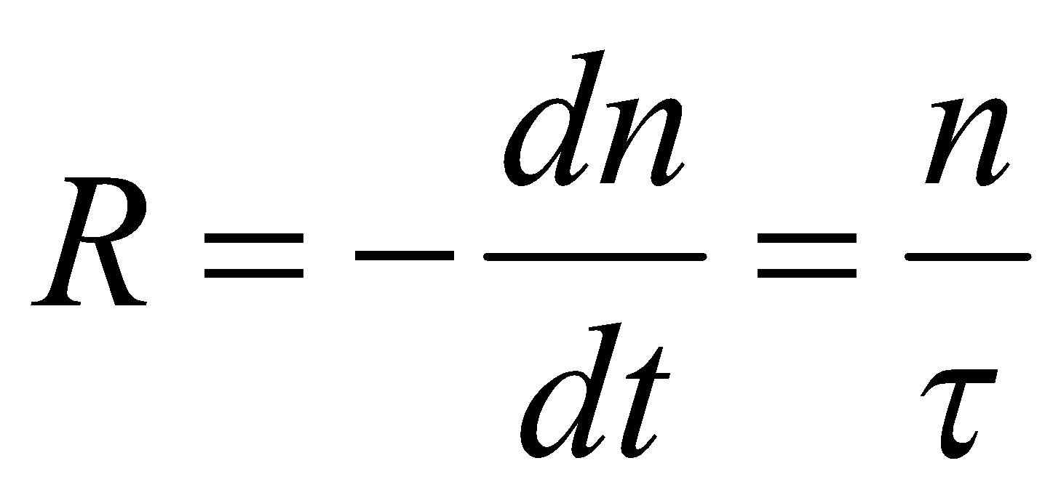
Rate equations, Quantum Efficiency & Power of LEDs
When there is no external carrier injection, the excess density decays exponentially due to electron-hole recombination.
n is the excess carrier density,
Bulk recombination rate R:
Bulk recombination rate (R)=Radiative recombination rate + nonradiative recombination rate
[4-4]
[4-5]

Slide 11
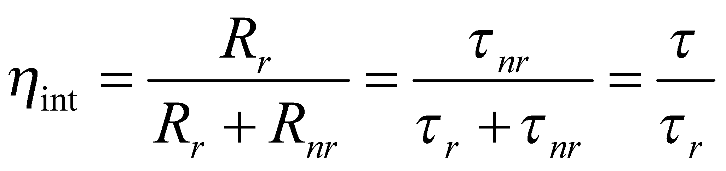
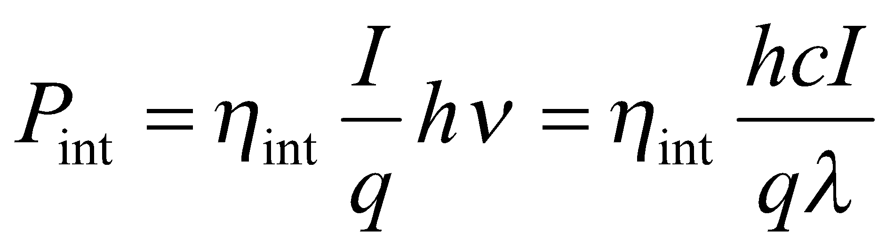
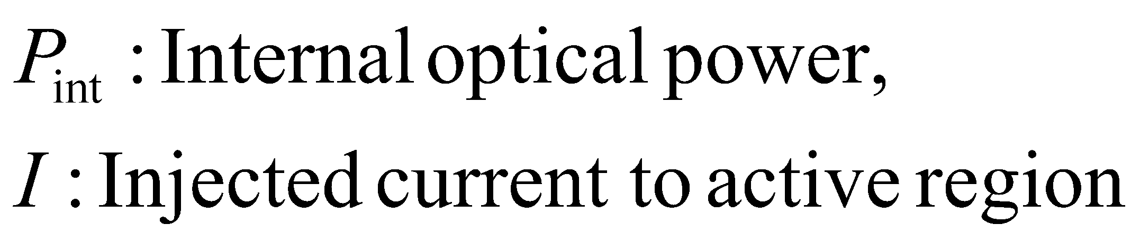
Internal Quantum Efficiency & Optical Power
[4-8]
Optical power generated internally in the active region in the LED is:
[4-9]

Slide 12
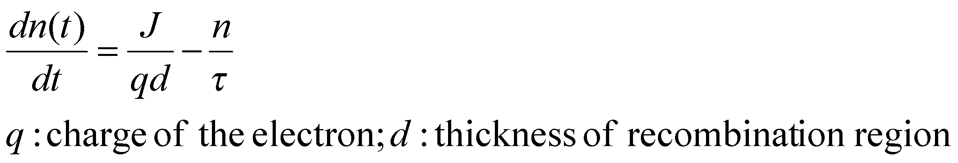
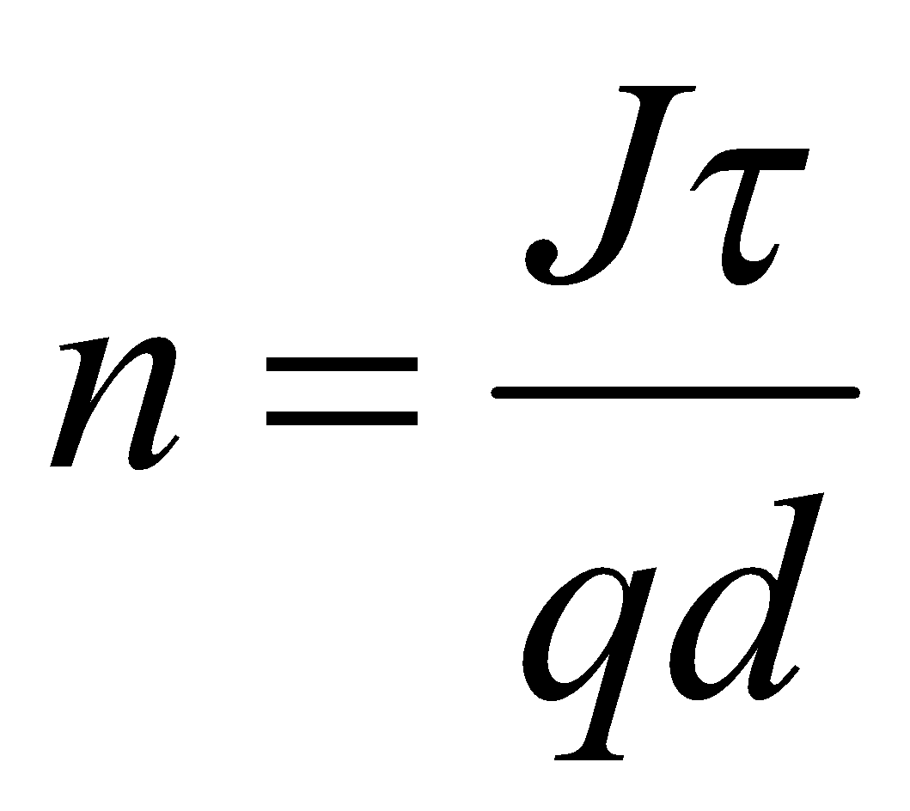
With an external supplied current density of J the rate equation for the electron-hole
recombination is:
[4-6]
In equilibrium condition: dn/dt=0
[4-7]

